Slide 1
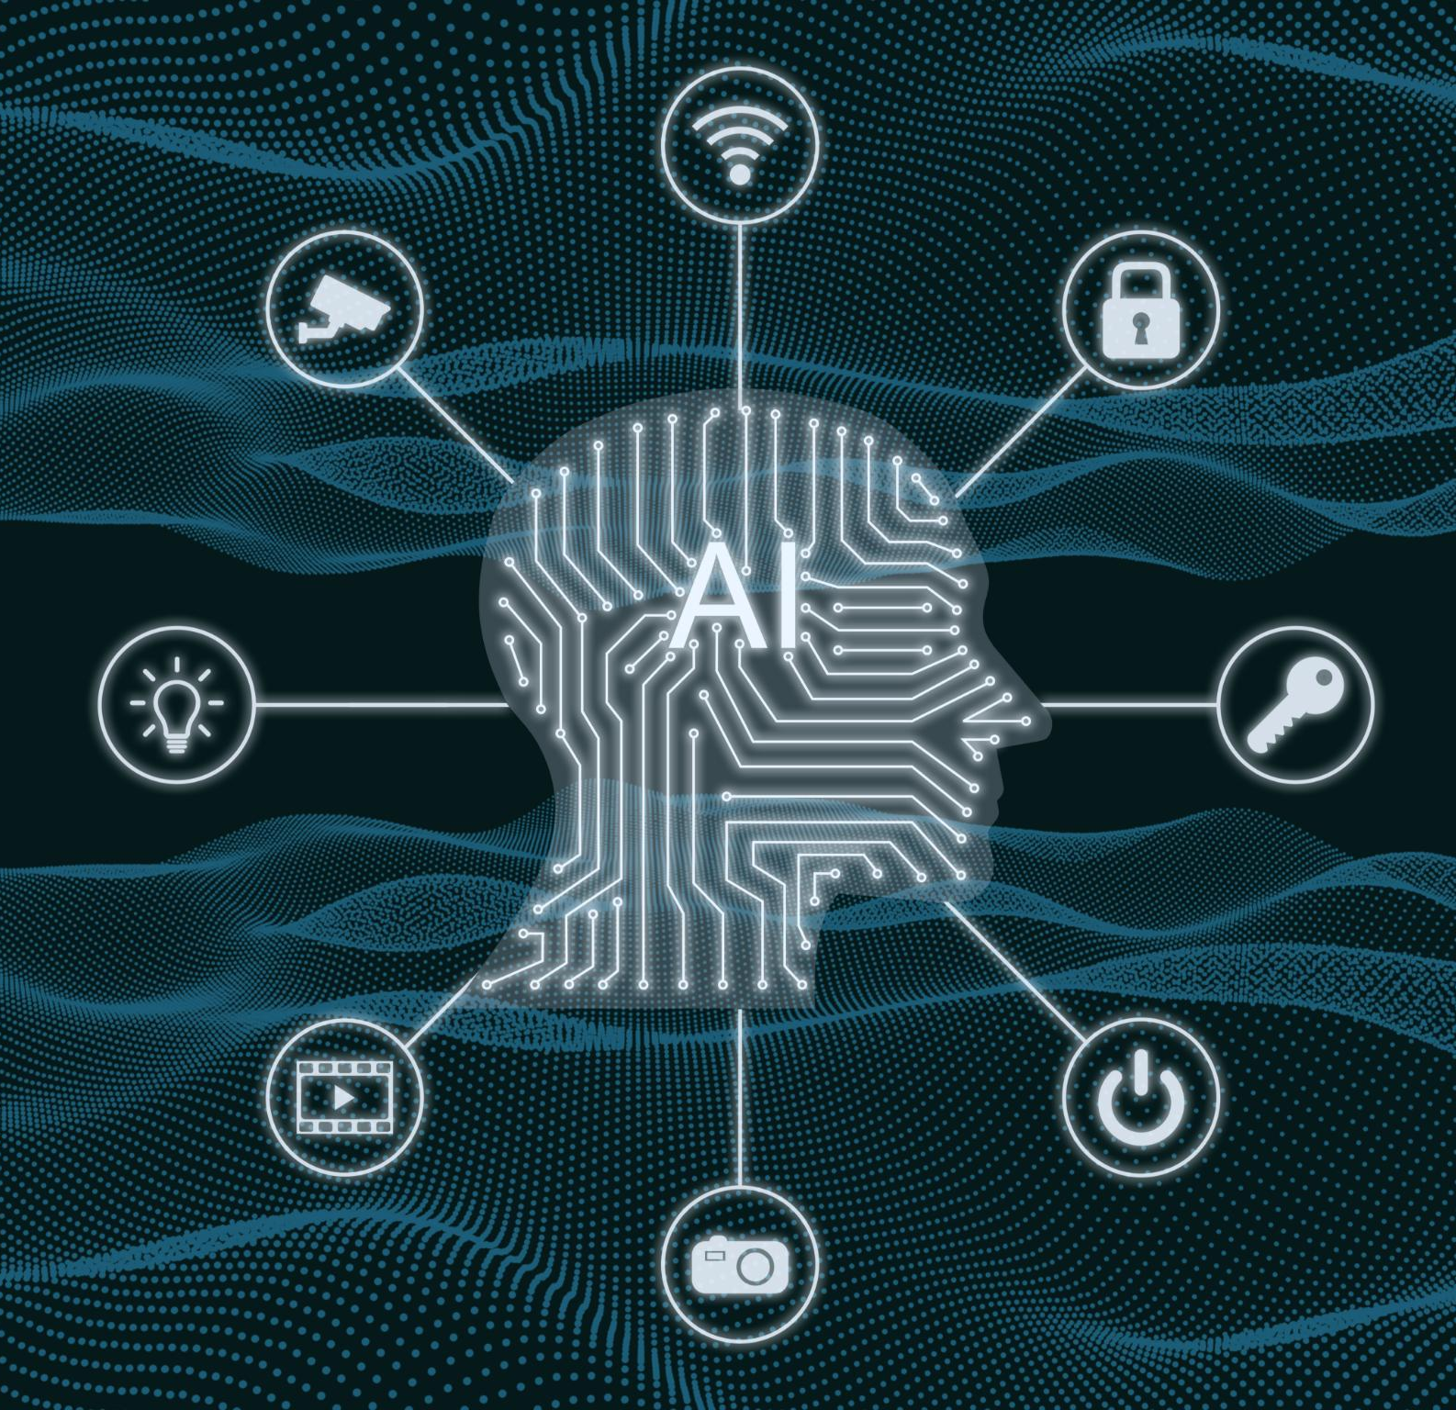
Will AI take our job by 2030?
“AI – Impact on Jobs 2030” Dataset – A Case Study
A Group B (Hackathon One) Project
Notes:
--- Recent developments include improved machine learning algorithms, natural language processing, and computer vision. These advancements enable more complex tasks like data analysis, decision-making, and creative work to be automated. Image source: Microsoft 365 content library

Slide 2
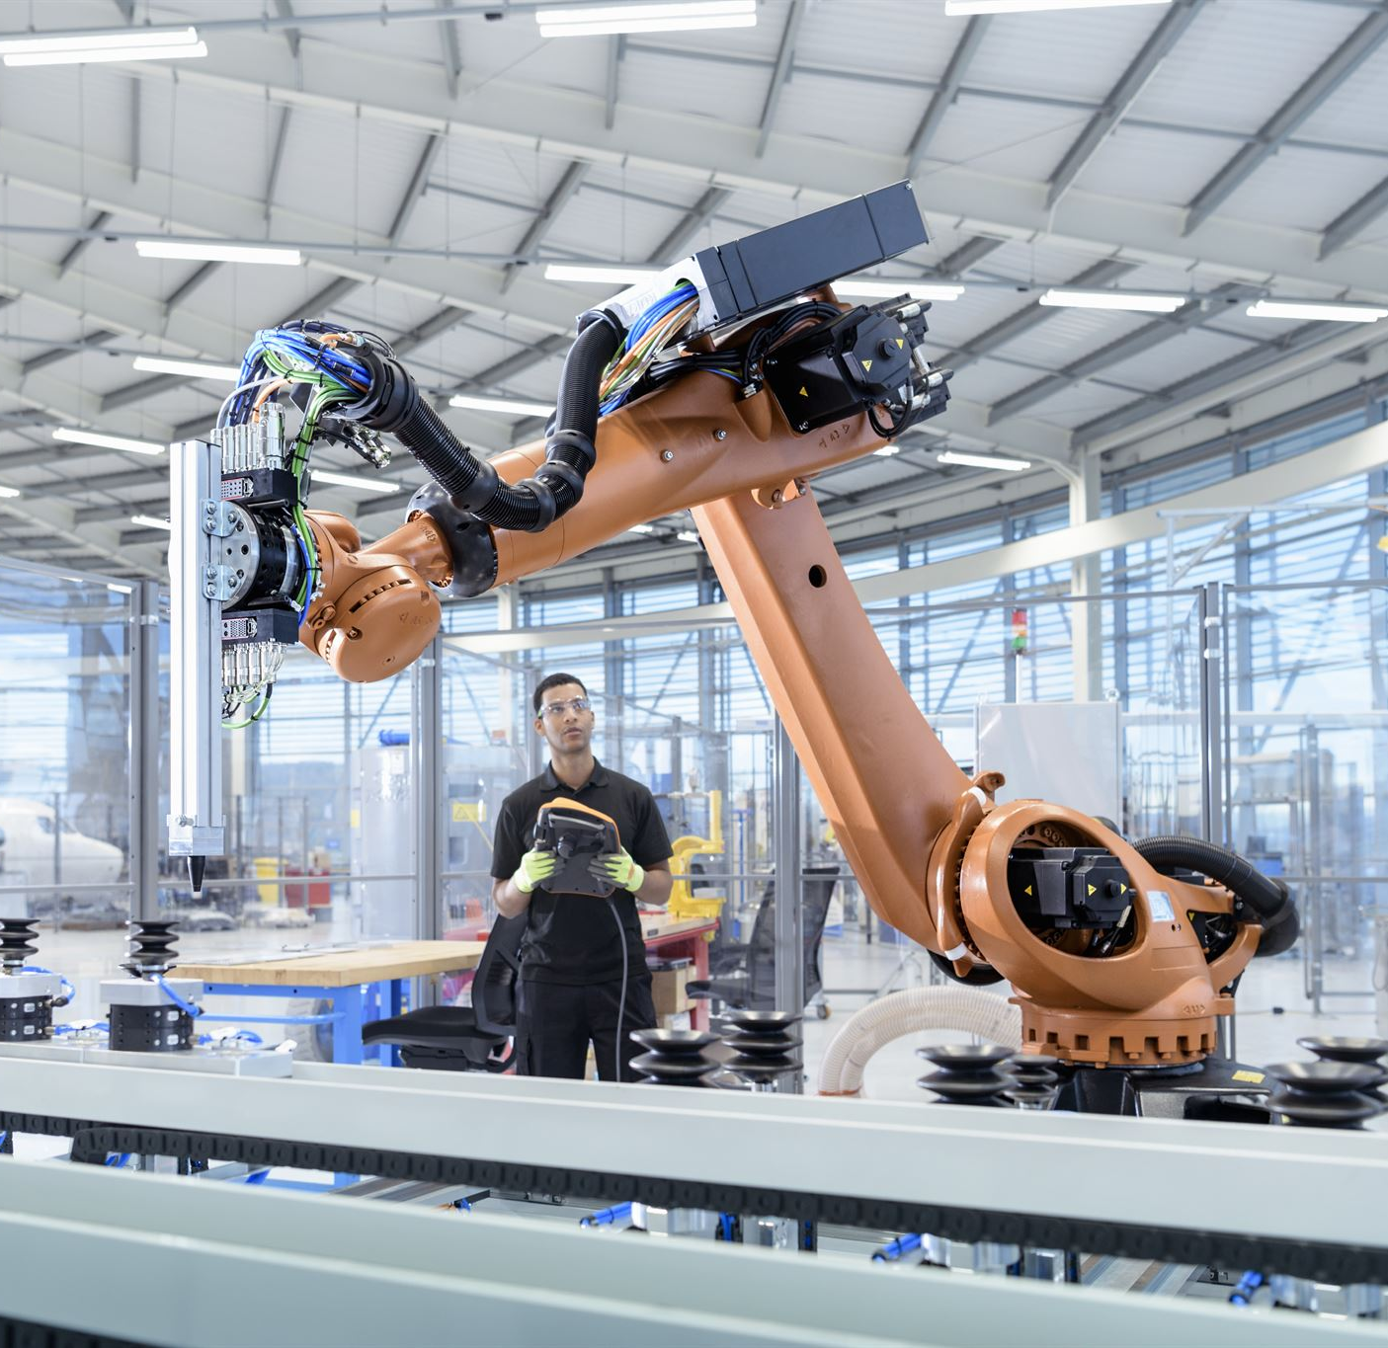
MAN Vs. MACHINE – history in one word
The word “Sabotage”
Song by the Beastie Boys, 1994.
Modern World Meaning:
“deliberately damaging, obstructing, or undermining something to weaken or stop it, especially in a workplace, political, or military context.”
From French folklore: Disgruntled factory workers threw wooden shoes, or ‘sabot’ into machines to disrupt production.
Notes:
--- Manufacturing, retail, and logistics employ many workers in routine tasks. These sectors are increasingly adopting automation like robotic assembly lines, automated warehouses, and self-checkout systems, displacing some human roles. Image source: Microsoft 365 content library

Slide 3
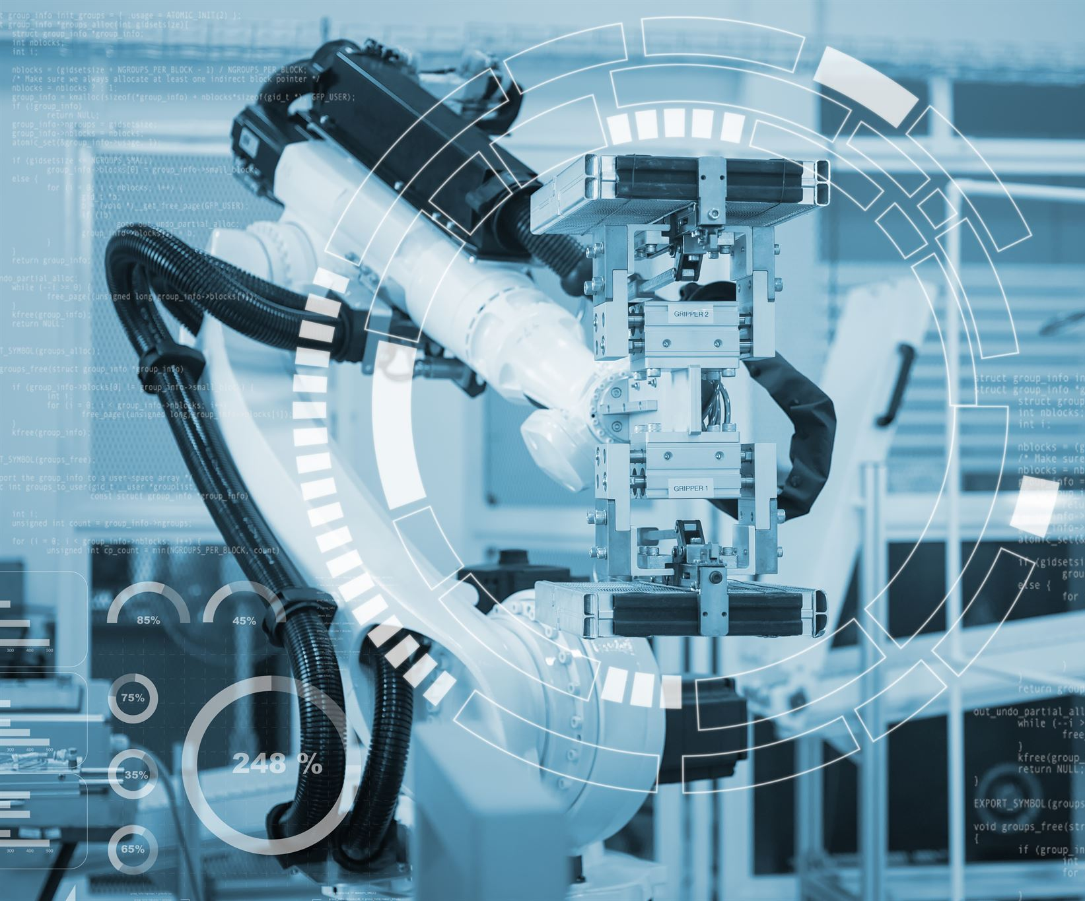
WHAT WE THINK THE ai DATASET SHOULD TELL US?
Top 5 Questions Asked:
Which jobs are most likely to be replaced by AI?
What factors (if any) are driving the ever-growing pace of AI in the job market?
Is there a link between Exposure to AI & AI Automation Probability?
Are we training AI to replace us?
Financial Status: Are the higher-earning jobs at risk?
Notes:
--- Automation is widely applied in manufacturing, customer service, logistics, and more. Technologies such as robotics, process automation, and AI-powered chatbots help improve efficiency and reduce human labor in repetitive tasks. Image source: Microsoft 365 content library

Slide 4
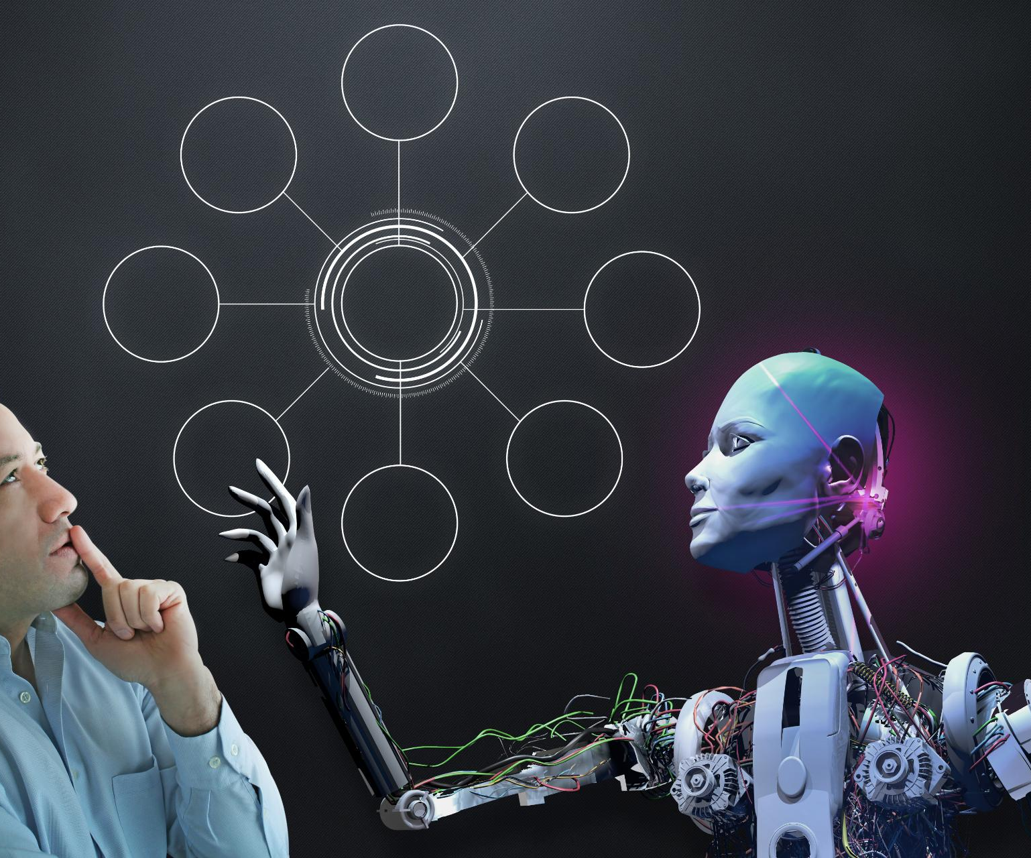
Ai dataset KEY insight:
“Quick & Dirty” (Initial) Analysis showed:
At-risk Jobs
Truck Drivers
Customer Support
Construction Worker
Security Guard
Retail worker
Safe-for-Now Jobs
AI Engineer
Research Scientist
Nurses
Teachers
Doctors
All other jobs
Approx. 50/50 chance of survival in 2030
Notes:
--- Jobs involving routine, predictable tasks are more susceptible to automation compared to those requiring creativity, complex problem-solving, and social interaction. This distinction influences which roles may be replaced or augmented. Image source: Microsoft 365 content library

Slide 5
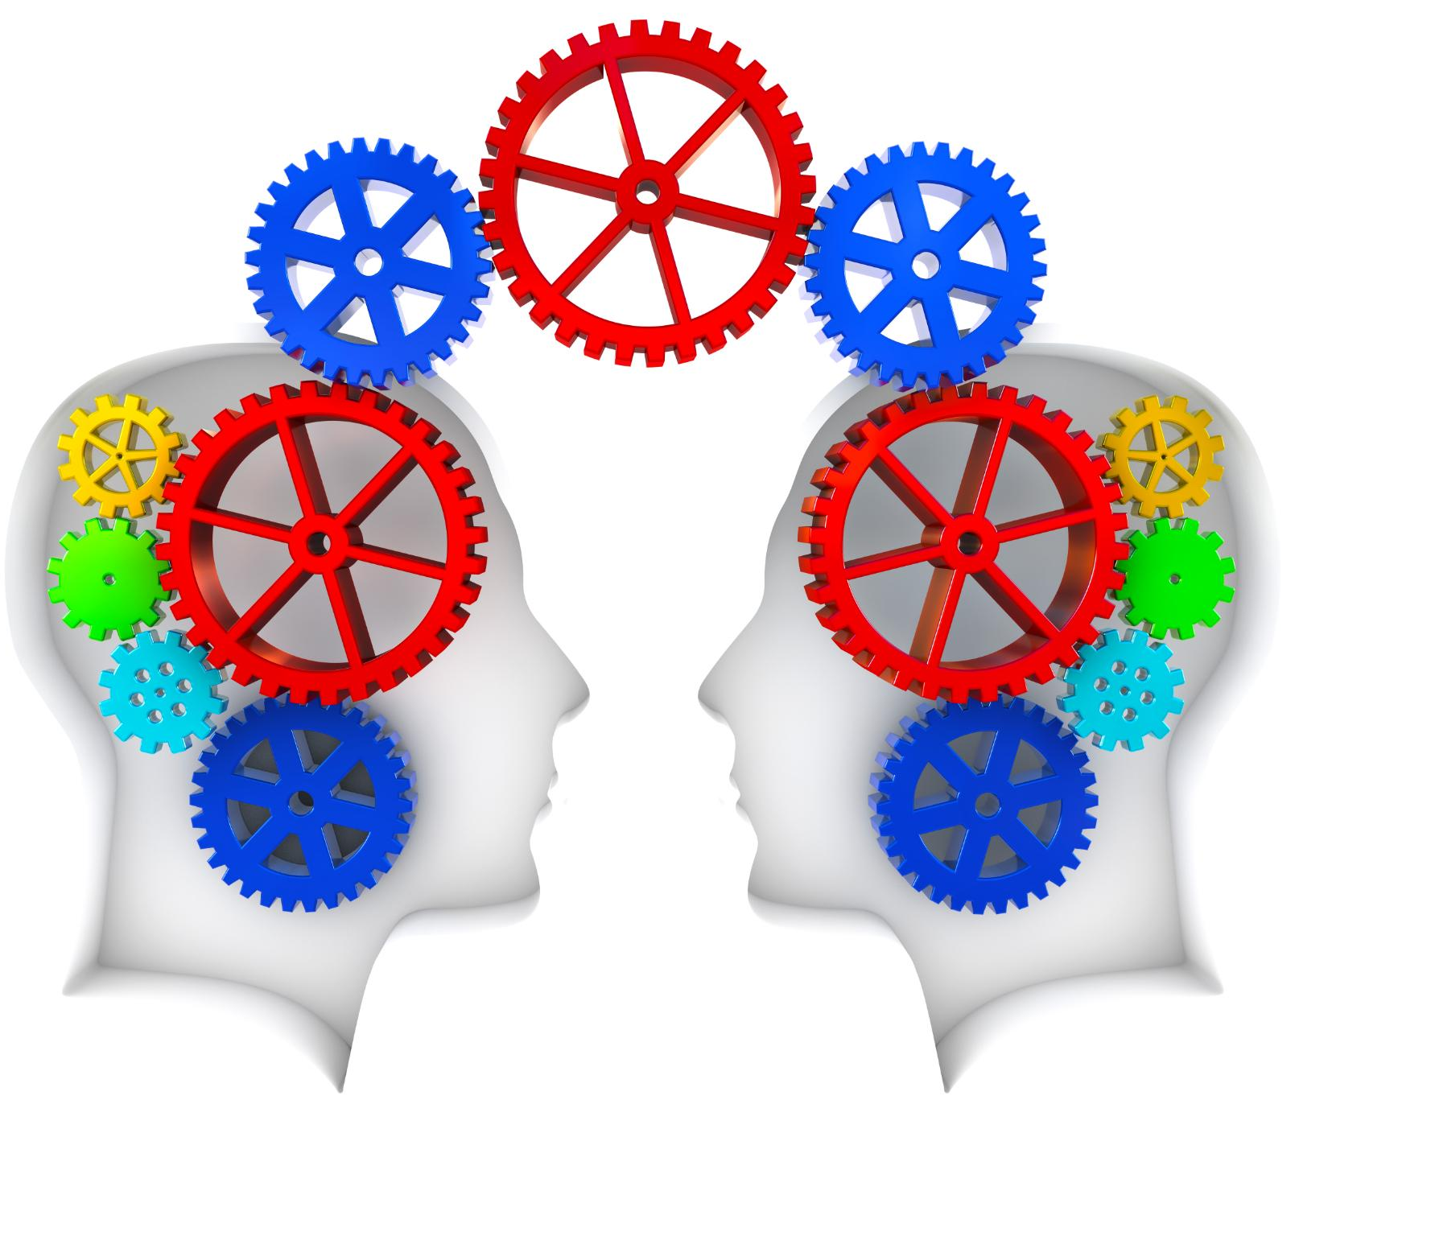
INITIAL Ai dataset - observations
Synthetic Dataset – was too ‘balanced’ (‘as-is’)
No direct/usable correlation between features
Unrealistically equal distribution across the numerical features
Similar average pay – around USD 90,000
Skills scoring averages around 5.0
Average AI Exposure around 5.0
Average Automation Probability (0.49 to 0.53)
At-risk jobs inconclusive without any Feature Engineering
Feature Engineering to the rescue! (‘to-be’)
Adding new features enhanced the dataset
Notes:
--- Skills such as critical thinking, complex communication, digital literacy, and emotional intelligence will become increasingly valuable as automation handles routine tasks, emphasizing uniquely human capabilities. Image source: Microsoft 365 content library

Slide 6

MACHINE LEARNING RESULTS USING NEW FEATURES
NEW FEATURES ADDED
Job Sector
Labour Group
MULTINOMIAL VS ORDINAL DISTRIBUTION
3 Risk category – order is important (low < medium < high)
MACHINE LEARNING MODELS USED – Irony?
Ordinal Scikit-Learn – Logistic Regression
Multinomial Statsmodels - LogisticAT
Random Forrest/Hyperparameter Tuning
PREDICTION RESULTS – Which ML Model won?
Random Forrest Scored – 99.33% Accuracy
Notes:
--- Ethical AI development emphasizes transparency, fairness, and accountability to ensure technology benefits society without compromising human rights and values. Image source: Microsoft 365 content library

Slide 7

TEAMWORK – MAKES THE DREAM WORK (Credit TO)
1. Data Analyst/Architect
- Babatunde Mushafau - Volodymyr Babunych - Teerachai (Tish) Srisasi
2. Group B - Project Managers
- Ace Pag - Stefano Gioia
3. Dashboards Design & Coding (Streamlit)
- Babatunde Mushafau
4. Dashboards Design & Coding (Power BI)
- Volodymyr Babunych
Notes:
--- Education systems and public policies play a critical role in preparing the workforce for changing demands through lifelong learning opportunities, social safety nets, and inclusive economic strategies. Image source: Microsoft 365 content library

